Slide 1
Number Theory 2
Application to Encryption

Slide 2
Linear congruence equations
Consider special congruence equation
ax  1 (mod m) where a  0 (mod m).
It’s solution is given by following theorem.
Theorem 11.25. If a and m are coprime, then ax  1 (mod m) has a unique solution, otherwise it has no solution.
Example. Consider 6x  1 (mod 33), then gcd(6,33)=3. Thus the equation has no solution.
Example. Consider 7x  1 (mod 9). Gcd(7,9) =1, so has unique solution. Test the numbers 0,1,2,…8.

Slide 3
Linear congruence equations
We consider the more general equation.
ax  b (mod m) where a  0 (mod m). Suppose a and m are coprime.
Theorem 11.26. Suppose a and m are relatively prime. Then ax  b (mod m) has a unique solution. And if s is the unique solution to ax  1 (mod m), then x = bs is the unique solution to ax  b (mod m).
Example. Consider 3x  5 (mod 8). Since 3 & 8 are coprime, it has a unique solution. Testing integers 0,1,…7, we find 3(7) = 21  5 (mod 8).

Slide 4
Linear congruence equations
Theorem 11.27. Consider equation ax  b (mod m) where d = gcd(a,m).
(i) Suppose d does not divide b. Then ax  b (mod m) has no solution.
(ii) Suppose d | b. Then there are exactly d incongruent solutions modulo m, given by x = x₀ + k(m/d), where x₀ is a particular solution of the Diophantine equation ax + my = b and k = 0,1,…,d – 1.
Example. 21x  9 (mod 30). Then x  9 (mod 30) is a solution. Find the other 2 solutions.

Slide 5
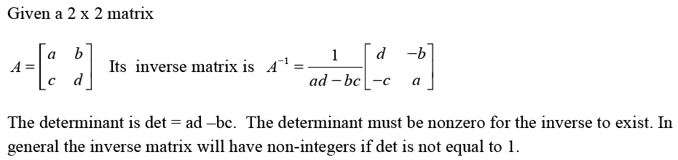
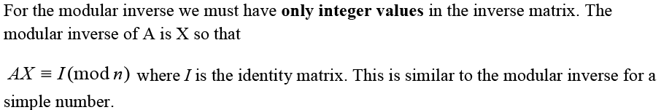
Modular Inverse of a 2x2 matrix

Slide 6



Slide 7



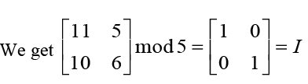

Slide 8


Slide 9
Modular Inverse – Matrix
The determinant is the term: a*d – b*c = det
For modular inverse, we cannot use 1/det as it’s not an integer usually. So we solve:
det*x  1(mod n) . Now x is modular inverse of det.
Also negative numbers are replaced by positive congruent (mod n) numbers.
From these we get the modular inverse of A.

Slide 14
Modular exponentiation
We often need to compute a^{b} (mod m), with a, b, m possibly large.
Example. Compute 5³ (mod 7).
5 mod 7 = 5,
5² mod 7 = 4,
5³ mod 7 = 125 mod 7 = 6,
or use (5² * 5) mod 7 = 4*5 (mod 7) = 6
So 5⁴ mod 7 = 6*5 (mod 7) = 2, etc.
We use these computations in public-key encryption algorithms.
Exercise: Compute 3¹⁰ mod 7, without a calculator.

Slide 15
Modular exponentiation
Example. Compute 5⁴⁰ mod 7.
Use rules of modular multiplication. Don’t need to find 5⁴⁰ on a calculator.
5¹ mod 7 = 5
5² mod 7 = 4
5⁴ mod 7 = 4² mod 7 = 2
5⁸ mod 7 = 2² mod 7 = 4
5¹⁶ mod 7 = 4² mod 7 = 2
5³² mod 7 = 2² mod 7 = 4
5⁴⁰ mod 7 = 5³² 5⁸ (mod 7) (4*4) mod 7 = 2
We can also use a ‘Fast Algorithm’ on computer to do this!

Slide 16
Modular exponentiation
Algorithm. Need binary form of exponent
function modular_pow (base, exponent, modulus)
result := 1
while exponent > 0
if (exponent % 2 = 1)
result = (result * base) mod modulus
exponent := exponent / 2
base = (base * base) mod modulus
return result

Slide 17
Chinese remainder theorem
An Ancient riddle (theorem) on congruences posed by Chinese mathematician Sun Tsu (3rd-5th century):
Is there a positive integer x such that when x is divided by 3 it gives remainder 2, when x is divided by 5 it given remainder 4, when divided by 7 it gives a remainder 6?
So we seek a solution of the following 3 congruence equations x  2 (mod 3)
x  4 (mod 5)
x  6 (mod 7)
Note: that the moduli 3, 5, 7 are pairwise coprime.
Also all solutions x of this system are congruent modulo N = 3*5*7

Slide 18
Chinese remainder theorem
Chinese remainder theorem: Given the system
x  r₁ (mod n₁)
x  r₂ (mod n₂) (1)
...
x  r_{k} (mod n_{k})
where the n_{i} are pairwise relatively prime. Then the system has a unique solution modulo N = n₁n₂… n_{k} .
There is an explicit formula for the solution of this system (1), which we state as following.
Let N₁ = N /n₁, N₂ = N /n₂ ,…, N_{k} = N /n_{k.} Then each pair N_{i} and n_{i} are coprime. Let s₁, s₂,…,s_{k} be the solutions of the congruence equations:

Slide 19
Chinese remainder theorem
Let s₁, s₂,…,s_{k} be the solutions of the congruence equations:
N₁x  1 (mod n₁)
N₂x  1 (mod n₂) (2)
...
N_{k} x  1 (mod n_{k})
Then X₀ = N₁s₁r₁ + N₂s₂r₂ +…+ N_{k}s_{k}r₁
is a solution of the system (1).
Note that N_{k}s_{k}  1 (mod n_{k}) for each k.
Let’s solve the Chinese congruence problem.

Slide 20
Chinese remainder theorem
First apply the theorem to 1st 2 equations.
x  2 (mod 3) (a)
x  4 (mod 5) (b)
Theorem says there is a unique solution modulo N = 3*5=15.
From 2nd one, adding multiples of the modulus n = 5 we obtain 3 solutions less than 15.
x = 4, 9, 14.
Testing each of these in equation (a) we find that x = 14 is the only solution of both equations. So we get
(c) x  14 (mod 15) and
(d) x  6 (mod 7)

Slide 21
Chinese remainder theorem
Theorem tells us there is unique solution modulo N = 15*7 = 105.
Adding multiples of modulus n = 15 to the solution x = 14 of the 1st equation (c) we obtain the solutions that are < 105.
14, 29, 44, 59, 74, 89, 104
Testing each of these solutions in equation (d), we find that 104 is the only solution of both (c) and (d). Thus
x = 104 is the smallest positive integer satisfying all 3 equations.
Method 2. We find
N = 357 = 105, N₁ = 105/3 = 35, N₂ = 105/5=21, N₃ = 15

Slide 22
Chinese remainder theorem
We now solve the congruence equations:
35x  1 (mod 3), 21x  1 (mod 5), 15x  1 (mod 7)
Reducing 35 mod 3, 21 mod 5 and 15 mod 7 we get:
2x  1 (mod 3), x  1 (mod 5), x  1 (mod 7)
Solutions of these are respectively:
s₁ = 2, s₂ = 1, s₃ = 1
We substitute into the formula x₀ = N₁s₁r₁ + N₂s₂r₂ +…+ N_{k}s_{k}r₁
to get solution of original system.
x₀ = 3522 + 2114 + 1516 = 314
Dividing this solution by the modulus N = 105, we get
x = 104, the unique solution between 0 and 105.

Slide 23
Fermat’s Little Theorem – FLT
French mathematician Fermat (1601-1665) proved
Fermat’s Little Theorem. If p is prime and a is an integer not divisible by p, then
a^{p-1}  1 (mod p)
Furthermore, for every integer a we have
a^{p}  a (mod p)
Example. 4⁴  1 (mod 5)
Exercise. Show that 2³⁴⁰  1 (mod 11), using Fermat’s Little Theorem. Note that 340 = 10*34 or 2³⁴⁰ = (2¹⁰)³⁴

Slide 24
RSA Encryption
A message is translated into a sequence of integers, e.g. a to z into 0 to 25.
Group integers together to form larger integers, representing block of letters.
Transform M, an integer representing plaintext, to C representing the ciphertext (the encrypted message) by
C = Me mod n (encrypted text)
Choose primes p, q and n = pq. Also choose e so that gcd(e,(p-1)*(q-1)) = 1. And decryption key d so that de  1 mod((p-1)(q-1)). Then plaintext can be recovered by
C^{d} mod n  Mde = M^{1+k(p-1)*(q-1)}  M (mod p)
C^{d} mod n  Mde = M^{1+k(p-1)*(q-1)}  M (mod q)

Slide 25
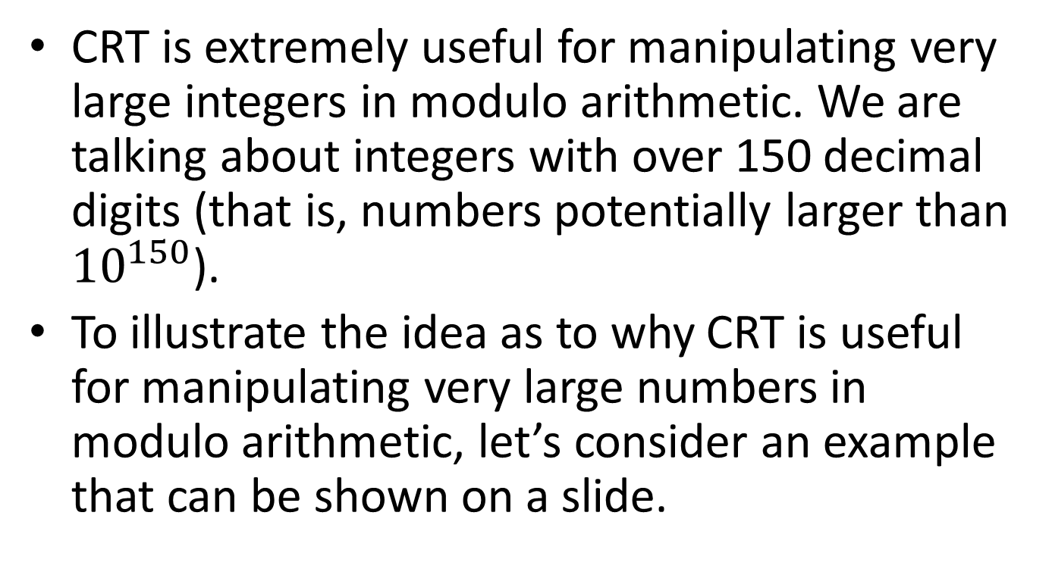
A demonstration of the usefulness of the CRT
CRT is extremely useful for manipulating very large integers in modulo arithmetic. We are talking about integers with over 150 decimal digits (that is, numbers potentially larger than ${10}^{150}$).
To illustrate the idea as to why CRT is useful for manipulating very large numbers in modulo arithmetic, let’s consider an example that can be shown on a slide.

Slide 26
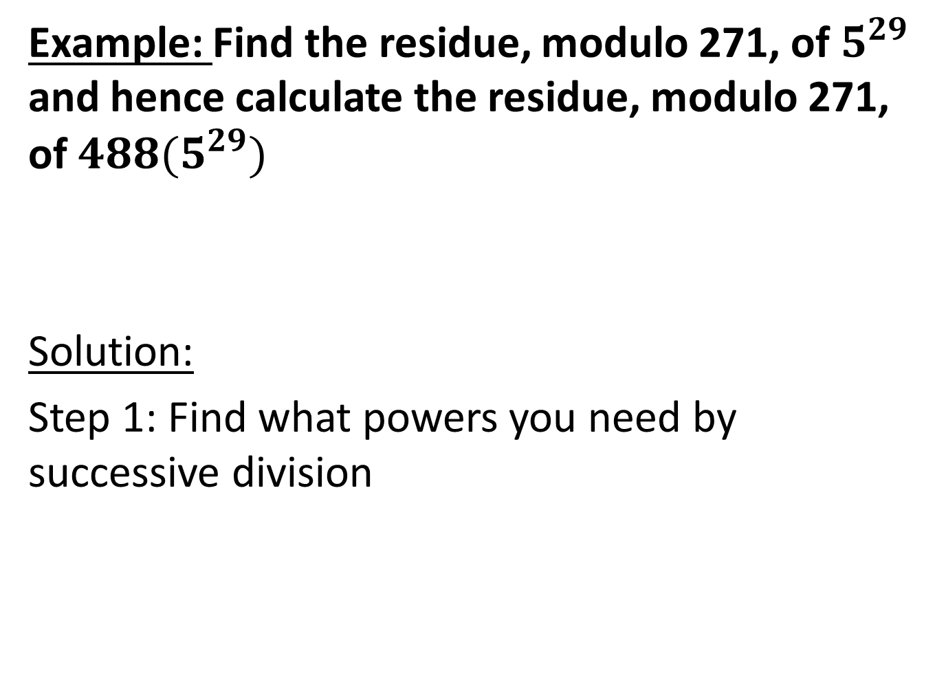
Example: Find the residue, modulo 271, of $5^{29}$ and hence calculate the residue, modulo 271, of $488(5^{29})$
Solution:
Step 1: Find what powers you need by successive division

Slide 27

29
14 1
7 0
3 1
1 1
0 1
i.e. ${29}_{10}=11101_{2}$
=${ 2}^{4}+2^{3}+2^{2}{+2}^{0}$
= 16 + 8 + 4 + 1…use these powers to find the overall power of 29.

Slide 28
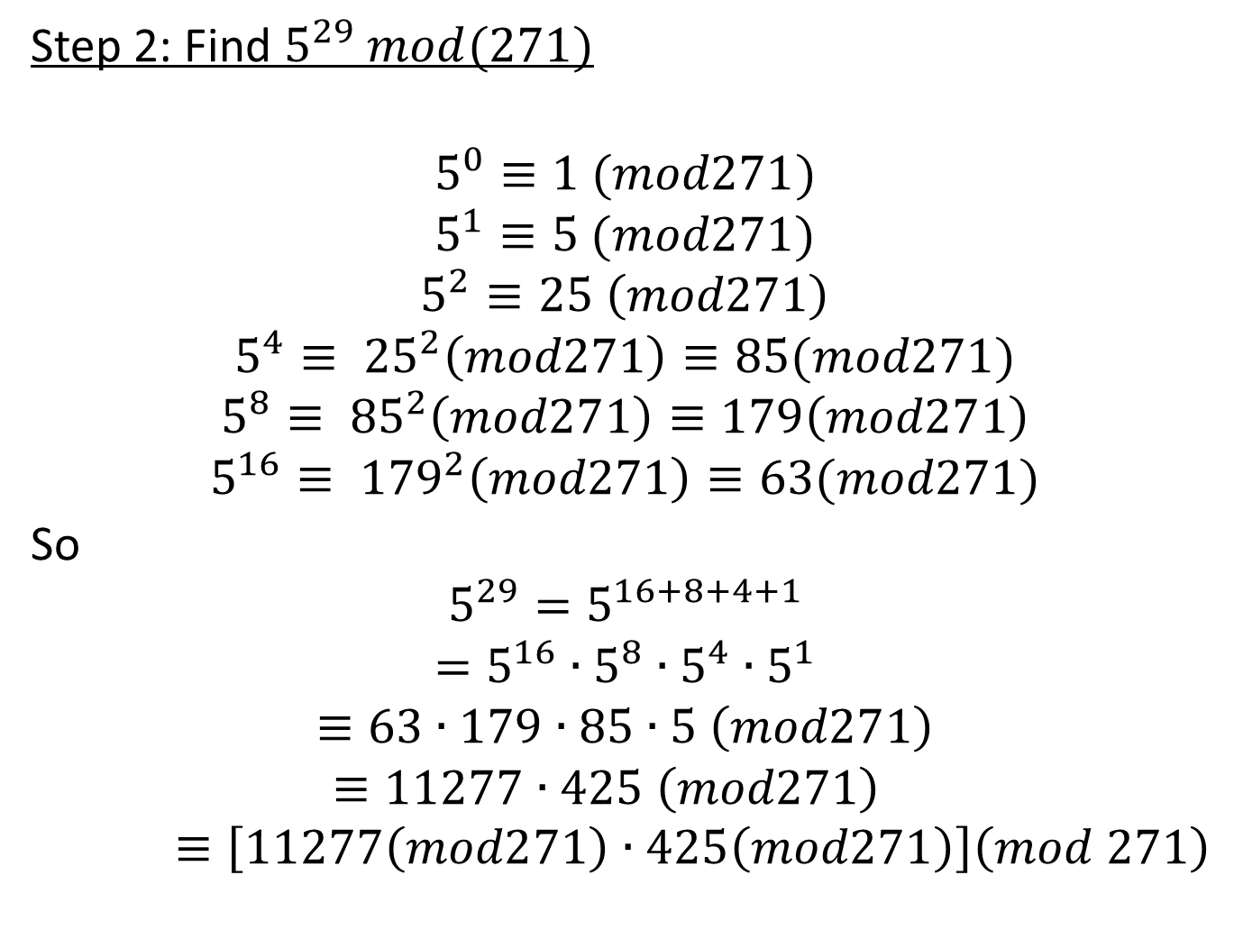
Step 2: Find $5^{29} mod(271)$
$$5^{0}≡1 (mod271)$$
$$5^{1}≡5 (mod271)$$
$$5^{2}≡25 \left(mod271\right)$$
$$5^{4}≡ {25}^{2}\left(mod271\right)≡85(mod271)$$
$$5^{8}≡ {85}^{2}\left(mod271\right)≡179\left(mod271\right)$$
$$5^{16}≡ {179}^{2}\left(mod271\right)≡63(mod271)$$
So
$$5^{29}=5^{16+8+4+1}$$
$$=5^{16}∙5^{8}∙5^{4}∙5^{1}$$
$$≡63∙179∙85∙5 \left(mod271\right)$$
$$≡11277∙425 \left(mod271\right)≡\left[11277\left(mod271\right)∙425\left(mod271\right)\right]\left(mod 271\right)$$

Slide 29
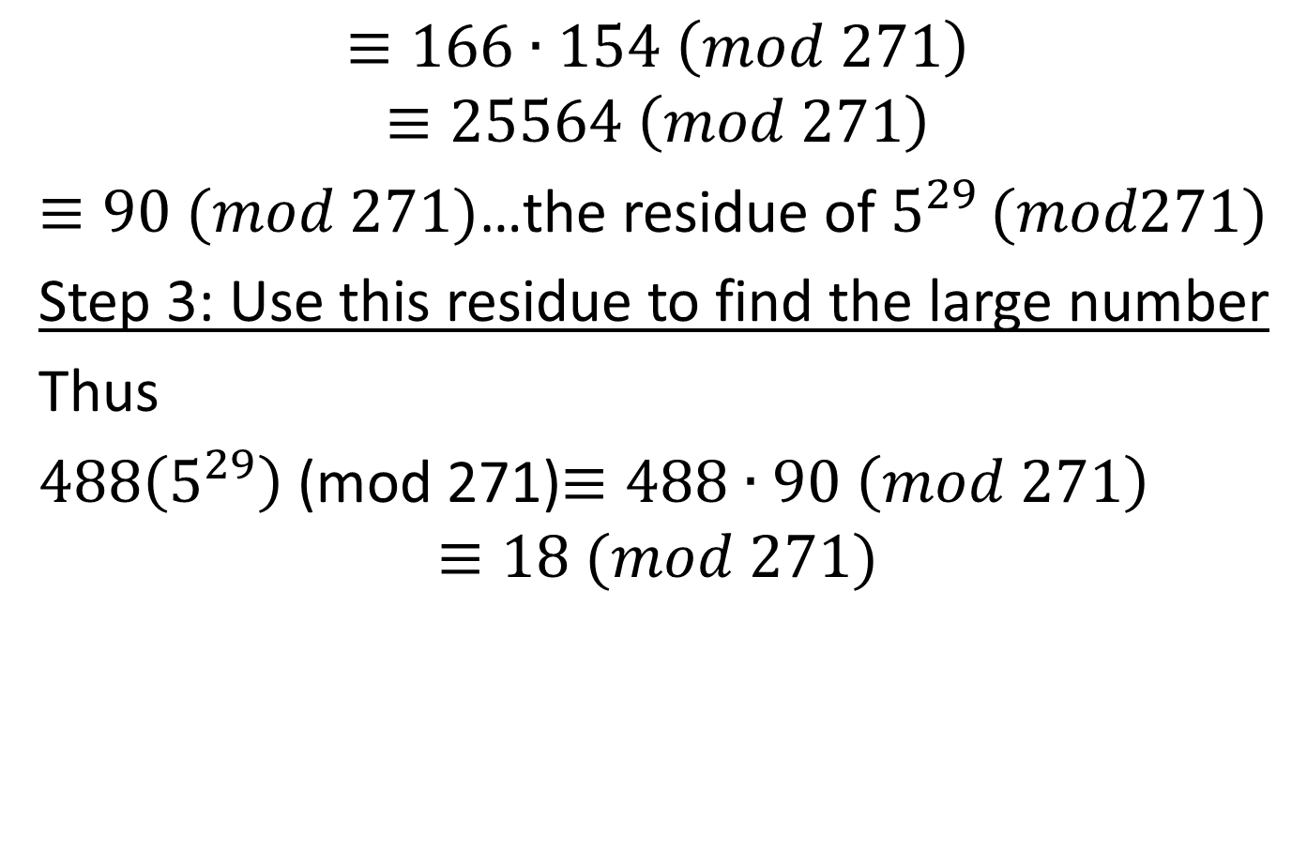
$$≡166∙154 \left(mod 271\right)$$
$$≡25564 \left(mod 271\right)$$
$≡90 (mod 271)$…the residue of $5^{29 }(mod271)$
Step 3: Use this residue to find the large number
Thus
$488\left(5^{29}\right)$ (mod 271)$≡488∙90 \left(mod 271\right)$
$$≡18 (mod 271)$$

Slide 30
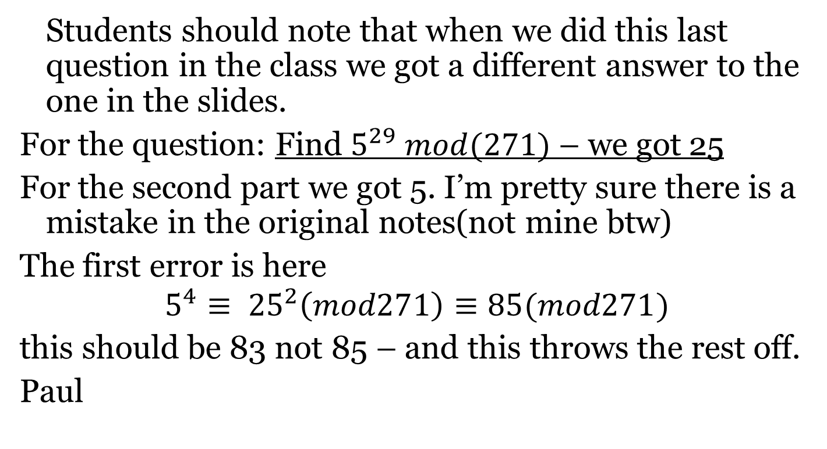
Students should note that when we did this last question in the class we got a different answer to the one in the slides.
For the question: Find $5^{29} mod(271)$ – we got 25
For the second part we got 5. I’m pretty sure there is a mistake in the original notes(not mine btw)
The first error is here
$$5^{4}≡ {25}^{2}\left(mod271\right)≡85(mod271)$$
this should be 83 not 85 – and this throws the rest off.
Paul

